Slide 1
DBpedia interlingual mapping
(Improving multilingual DBpedia)
Mart Busger op Vollenbroek
Olivier Louwaars
Charles Tsang

Slide 2
Contents
Cause & Goal
Method
Results

Slide 3
Cause
Multilngual DBpedia Ontology (http://dbpedia.org/ontology/)
Property in English vs. Dutch (example):
EN:
Birthdate : http://dbpedia.org/ontology/birthDate
NL:
http://nl.dbpedia.org/ontology/birthDate
Geboortedatum: http://nl.dbpedia.org/property/geboortedatum
Geboren: http://nl.dbpedia.org/property/geboren
Gbdat: http://nl.dbpedia.org/property/gbdat

Slide 4
Goal
Map Dutch properties to the English DBpedia Ontology
  More efficient queries in SPARQL in any language
  Cleaner DBpedia pages
Example: Alan Turing

Slide 5
Method
mappingbased-properties_nl.nt (1,74 GB)
infobox-properties_nl (2,43 GB)
Instance-types_NL.nt (369 MB)
Focus on dates for overview and development
  127.831 ontology mappings
  219.139 Dutch DBpedia dates
Look up pagetype
Match by value
Create .RDF
  type <propNL> <SameAs> <DBontology>

Slide 6
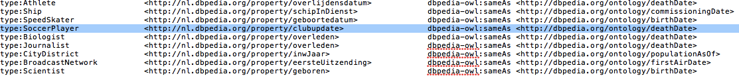
Results
45 to 35 to 25 minutes runtime
499 datetypes
166 datetypes matched to ontology
320 datetype/pagetype combinations matched to ontology (64%)
297 correct (92,81%)
Notes:
Speed: lists to dicts to keys
Swimmer/writer/person all have a birthdate field

